Slide 1
Data Modelling, Management & Governance CIS108-6
Lecture 3:
Data Modelling (ERM, ERD, RDM)
Gangmin Li

Slide 2
Review
Data Management Systems
A system that defining, unifying and managing data in its entire lifecycle to achieve accurate and efficient of data usage. A data management system will be looking into: Data governance, Data modelling and design, Data storage architecture and management, Data security and integration and Data usage (data mining, analysis and BI)
Database Management Systems (DBMS)
A Database Management System (DBMS) is a system designed to store, manage, and facilitate access to databases to ensure data security and data integrity. Functions are including operational and maintenance operations.
Types: Hierarchical, Network, Relational (RDBMS), Object-Oriented (O-ODBMS), NoSQL and Graph databases

Slide 3
A data system design process
Conceptual Design
Requirements collection and analysis
Develop Conceptual Data Model
Develop Logical Data Model & Normalisation
ERM Database Design
Logical Design
Physical Design
Physical Design
Build Database

Slide 4
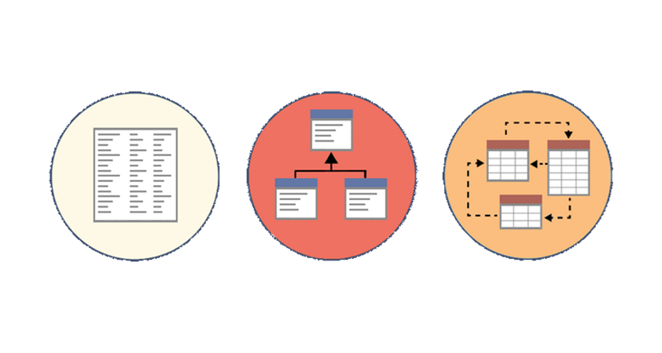
Data Modelling
The core activity in a data system design

Slide 5
What is Data Modelling?
Data modelling is the process of creating a data model for the data to be stored in a data system (database). This data model is a conceptual representation of Data objects, the associations between different data objects, and the relations.
Data modelling helps in the visual representation of data and enforces business rules, regulatory compliances, and government policies on the data. Data Models ensure consistency in naming conventions, default values, semantics, security while ensuring quality of the data.

Slide 6
What is a Data Model?
A Data Model is an abstract model that organizes data description, data semantics, and consistency constraints of data.
The data model emphasizes on what data is needed and how it should be organized instead of what operations will be performed on data.
Data Model helps operations on the data to get data insight and value out of it.

Slide 7
Why use Data Model?
Accurate presentation: Ensures that all data objects required by the data system are accurately represented. Omission of data will lead to creation of faulty reports and produce incorrect results.
Helps in a database design: A data model helps a database design at the conceptual, physical and logical levels.
Helps select appropriate database types. It provides a clear picture of the base data and can be used by database developers to select and create a physical database (centre).
Reduce data system maintenance cost. The initial creation of data model is time consuming, in the long run, it makes your IT infrastructure upgrade and maintenance cheaper and faster.

Slide 8
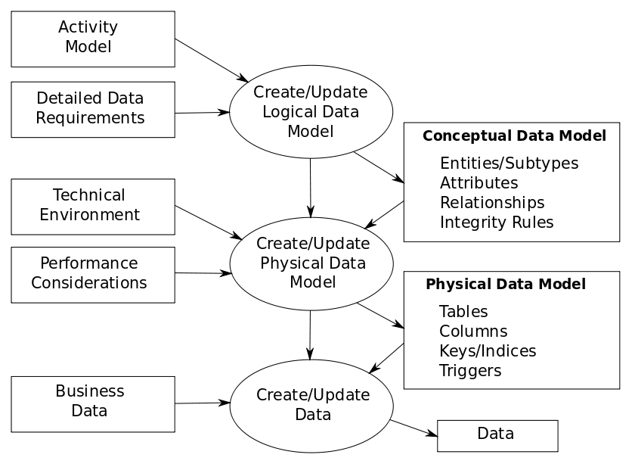
Process of Data modelling
Notes:
The data modelling process. The figure illustrates the way data models are developed and used today . A conceptual data model is developed based on the data requirements for the application that is being developed, perhaps in the context of an activity model. The data model will normally consist of entity types, attributes, relationships, integrity rules, and the definitions of those objects. This is then used as the start point for interface or database design.

Slide 9
Types of Data Models
There are mainly three different types of data models: conceptual data models, logical data models, and physical data models, and each one has a specific purpose.
Conceptual Data Model: This Data Model defines WHAT the system contains. This model is typically created by Business stakeholders and Data Architects. The purpose is to organize, scope and define business concepts and rules.
Logical Data Model: Defines HOW the system should be implemented regardless of the DBMS. This model is typically created by Data Architects and data structures.
Physical Data Model: This Data Model describes HOW the system will be implemented using a specific DBMS system. This model is typically created by DBA and developers. The purpose is actual implementation of the database.

Slide 10
Conceptual Data Model
A Conceptual Data Model is an organized view of database concepts and their relationships. The purpose of creating a conceptual data model is to establish entities, their attributes, and relationships.
Separation of conceptual model: In this data modelling level, there is hardly any detail constraints available on the actual database structure.
A conceptual data model is typically created by Business stakeholders and data architects

Slide 11
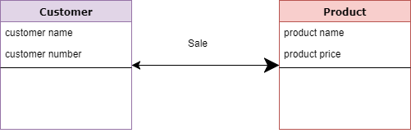
Example of Conceptual Data Model
Customer and Product are two entities. Customer number and name are attributes of the Customer entity
Product name and price are attributes of product entity
Sale is the relationship between the customer and product

Slide 12
Logical Data Model
The Logical Data Model is used to define the structure of data elements and to set relationship details (such as constraints) between them.
The logical data model adds further information to the conceptual data model elements make sure they are consistent in a wide application domain.
The advantage of using a Logical data model is to provide a foundation to form the base for the Physical model. However, the modelling structure remains generic and separation for the physical model.

Slide 13
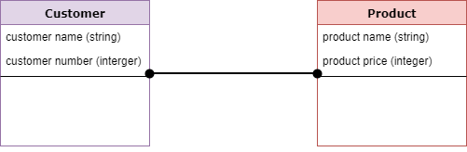
Example of local model
Add Data attributes types and exact precisions and length (30 characters).
Constrain relations (one customer can only (at least) buy 30 products.)
** Normalization processes to the model is applied typically till 3NF.

Slide 14
Physical Data Model
A Physical Data Model describes a database-specific implementation of the data model.
It offers database abstraction and helps generate the schema for a specific type of database. This is because of the richness of meta-data offered by a Physical Data Model.
Graphic database has triples (triple store) <node><REL><node>
Key-value pair <Key: value>
The physical data model also helps in visualizing database structure by replicating database column keys, constraints, indexes, triggers, and other DBMS specific features.

Slide 15
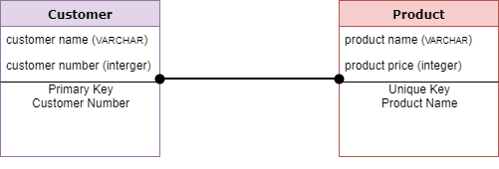
Example of Physical model
The physical data model describes data need for a single project or application
Developed for a specific type/version of a DBMS, location, data storage or technology to be used
Primary and Foreign keys, views, indexes, access profiles, and authorizations, etc. are defined.
E.g. in RDBMS contains relationships between tables that which addresses cardinality and nullability of the relationships.

Slide 16
Entity Relationship Modelling (ERM)
Basic Data modelling techniques for data conceptual model

Slide 17
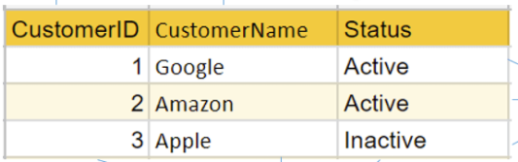
What is Entity Relationship Model?
ERM stands for “Entity-Relationship” modelling, it defines the real-world entities and relationships.
A relation (in RDBMS) is represented and stored as a table.
Rows in the table represent a collection of related data (object, record). These rows in the table denote a real-world entity or relationship.
The table name and column names are helpful to interpret the meaning of values in each row.
Understand ER Model will help to design RDB.

Slide 18
Basic concepts of ERM
Entity: An entity can be a real-world object, that can be easily identifiable.
E.g. in a school database, students, teachers, classes, and courses offered can be considered as entities. All these entities have some attributes or properties that give them their identity.
An entity set is a collection of similar types of entities. An entity set may contain entities with attribute sharing similar values.
E.g. a Students set may contain all the students of a school; likewise a Teachers set may contain all the teachers of a school from all faculties.
Cardinality defines the number of entities in one entity set, which can be associated with the number of entities of other set via relationship set.

Slide 19
Attributes
Attributes: Entities’ properties. All attributes have values. E.g. a student entity may have name, class, and age as attributes.
Domain: the range of the attributes’ value. E.g. a student's name cannot be a numeric value. It has to be alphabetic. A student's age cannot be negative, etc.
Types of Attributes
Simple attribute − Simple attributes are atomic values, which cannot be divided further. For example, a student's phone number is an atomic value of 11 digits.
Composite attribute − Composite attributes are made of more than one simple attribute. For example, a student's complete name may have first_name and last_name.
Derived attribute − Derived attributes are the attributes that do not exist in the physical database, but their values are derived from other attributes present in the database. For example, average_salary in a department should not be saved directly in the database, instead it can be derived. For another example, age can be derived from data_of_birth.
Single-value attribute − Single-value attributes contain single value. For example − Social_Security_Number.
Multi-value attribute − Multi-value attributes may contain more than one values. For example, a person can have more than one phone number, email_address, etc.

Slide 20
Keys
Key is an attribute or collection of attributes that uniquely identifies an entity among entity set.
For example, the roll_number of a student makes him/her identifiable among students.
Super Key − A set of attributes (one or more) that collectively identifies an entity in an entity set.
Candidate Key − A minimal super key is called a candidate key. An entity set may have more than one candidate key.
Primary Key − A primary key is one of the candidate keys chosen by the database designer to uniquely identify the entity set.

Slide 21
Relationship
Relationship: The association among entities. For example, an employee works_at a department, a student enrols in a course. Here, Works_at and Enrols are called relationships.
Relationship Set: A set of relationships of similar type. Like entities, a relationship can have attributes. These attributes are called descriptive attributes.
Degree of Relationship: The number of participating entities in a relationship defines the degree of the relationship.
Binary = degree 2
Ternary = degree 3
n-ary = degree

Slide 22
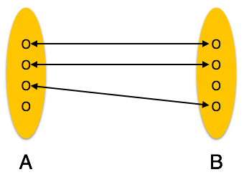
Cardinalities
One-to-one − One entity from entity set A can be associated with at most one entity of entity set B and vice versa.

Slide 23
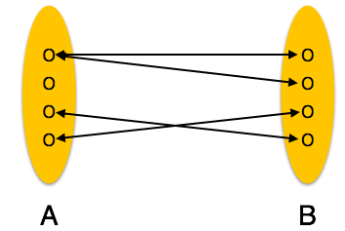
Cardinalities
One-to-many − One entity from entity set A can be associated with more than one entities of entity set B however an entity from entity set B, can be associated with at most one entity.

Slide 24
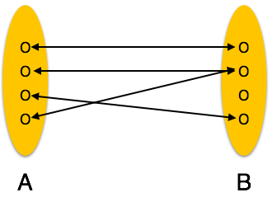
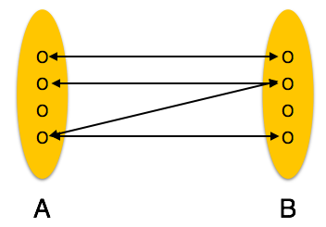
Cardinalities
Many-to-one − More than one entities from entity set A can be associated with at most one entity of entity set B, however an entity from entity set B can be associated with more than one entity from entity set A （below Left）.
Many-to-many − One entity from A can be associated with more than one entity from B and vice versa.

Slide 25
Conceptual Modelling: Steps
Identify entities
Indentify attributes
Identify relationships between entities
Determine attribute domains (e.g. datatypes)
Determine candidate primary keys
Draw entity relationship diagram
Review conceptual model with user/scenario

Slide 26
…tips…..
Follow the steps below to identify and model entities:
Examine the nouns. Are they things of significance?
Name each entity.
Is there information of interest about the entity that the business needs to hold?
Name each attribute.
Diagram each entity and a few of its attributes.

Slide 27
ERM Conventions
ENTITY:
Shown as rectangle with name in top section
Box with any dimensions
Singular, unique name
Name in upper case
Optional synonym name in parentheses
ATTRIBUTES:
listed in bottom section
Name in lower case
Unique entity ID (Primary Key) underlined
NAME
# Employee Number
First Name
Last Name
Job
Hire Date
Salary

Slide 28
Example Entity and Attributes
You are managing the human resources department for a large company. You need to keep information about each of your company’s employees including first & last name, job, hire date & salary. Every employee is assigned to a unique employee number.
EMPLOYEE
# Employee Number
First Name
Last Name
Job
Hire Date
Salary

Slide 29
RELATIONSHIPS
A relationship is two-directional, significant association between two entities.
Example:
Each COURSE may be taught by one and only one INSTRUCTOR.
Each INSTRUCTOR may be assigned to one or more COURSEs.
INSTRUCTOR
(Teacher)
Name
Phone number
COURSE
Code
Name
Fee
Duration
COURSE
Code
Name
Fee
Duration
STUDENT
Name
Phone number

Slide 30
Some Examples of Cardinalities
1. A blind person owns a guide dog
1
1
Blind Person
owns
Guide Dog
2. A doctor treats many patients
1
N
Doctor
treats
Patients

Slide 31
Simple Examples
3. A film may have many stars and
each star may be in many films.
N
N
Film
has
Stars

Slide 32
ER Diagram - Notations
2. ER Model representation

Slide 33
Chen’s Notation
Dr. Peter Chen, then a professor at Massachusetts Institute of Technology, proposed a new entity-relationship model for database design in 1976.
Dr. Chen’ notation (is very similar with the ER diagram) is constructed using a more natural view of how the real world comprises entities and the relationships that exist with these identified entities.
Major Design Elements
Relationship
Entity
Attribute
Entity
Attribute
Relationship

Slide 34
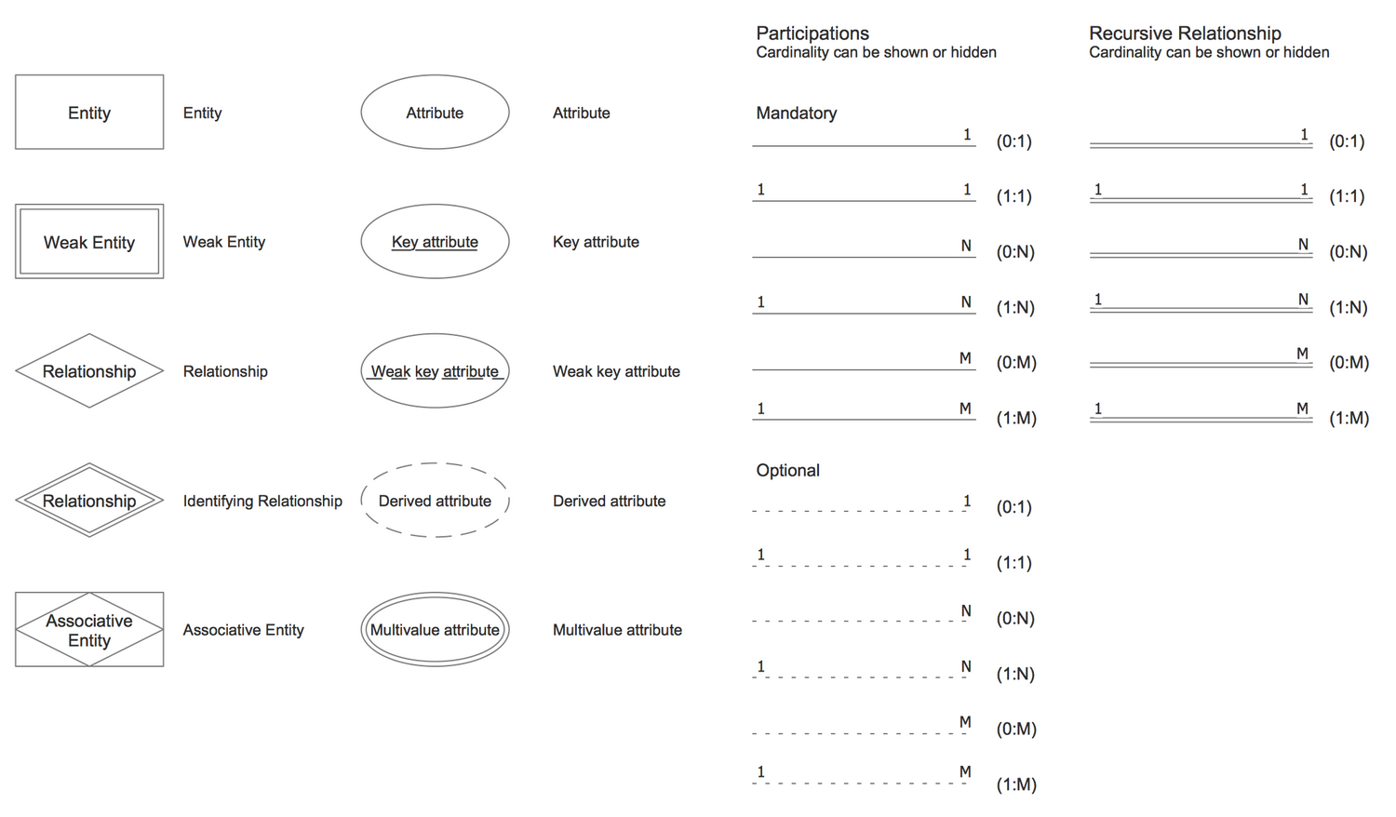
Chen’s Notation of ER model

Slide 35
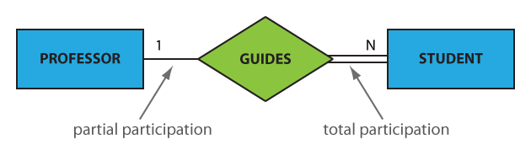
Participation Constraints
An entity set may participate in a relation either totally or partially.
Total participation means that every entity in the set is involved in the relationship, e.g., each student must be guided by a professor (there are no students who are not guided by any professor). In the Chen notation, this kind of relation is depicted as a double line.
Partial participation means that not all entities in the set are involved in the relationship, e.g., not every professor guides a student (there are professors who don’t). In the Chen notation, a partial participation is represented by a single line.

Slide 36
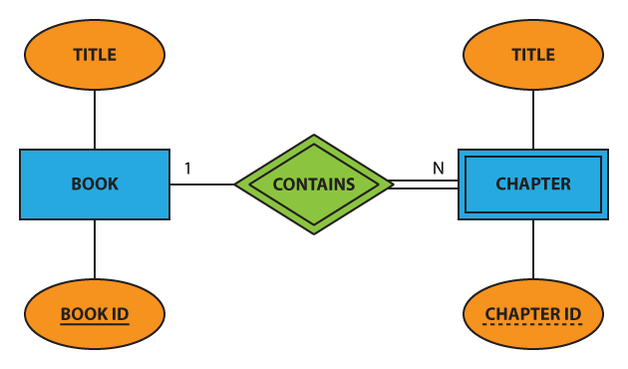
Chen’s Notation Examples https://vertabelo.com/blog/chen-erd-notation/

Slide 37
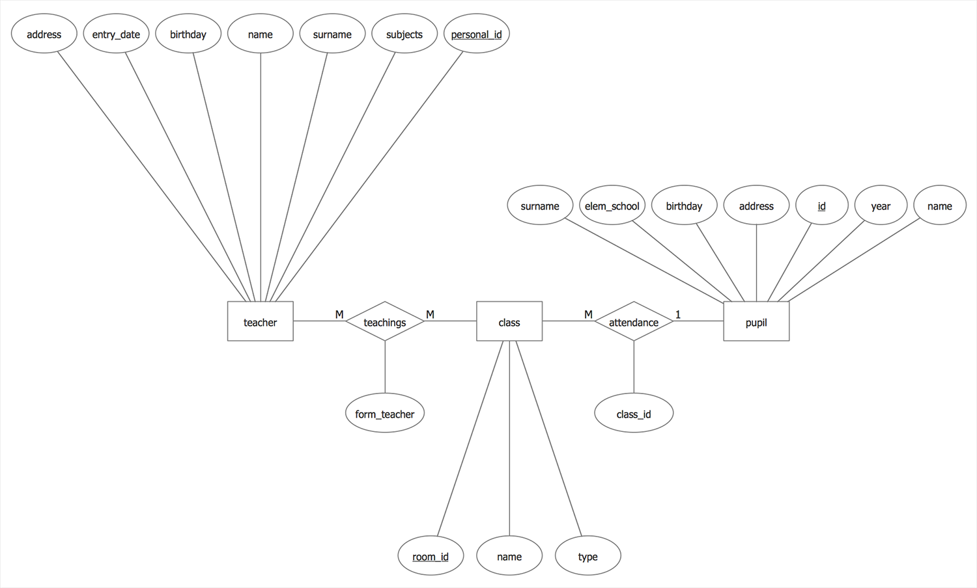
Chen’s Notation Examples

Slide 38
Exercise 1-University Database
Problem Definition:
A University is made up of many Faculties/Schools.
The DEAN is the head of every Faculty/School.
The DEAN is PROFESSOR
Every Faculty is made up of several departments.
For example, the UoB is made of many Faculties and we belong to the Faculty of Creative Arts, Technology and Science (CATS). The Faculty of CATS is made up of CST, Department of Science, Department of Journalism & Communications, Department of Performing Arts & English ….just to name a few.

Slide 39
School
Department
Professor
1
1
1
M
Is DEAN of
Operates

Slide 40
Each DEPARTMENT has many PROFESSORS ASSIGNED to it.
One of those PROFESSORS HEADS the DEPARTMENT.
Only one of the PROFESSORS can HEAD the DEPARTMENT to (s)he is assigned, and no PROFESSOR is required to accept the chair position. Therefore, DEPARTMENT is optional to PROFESSOR in the “HEADS” relationship.

Slide 41
M
ASSIGNED
1
Department
Professor
Professor
HEADS
Department
1
1

Slide 42
Each DEPARTMENT OFFERS several courses.
A COURSE can HAVE many UNITS.

Slide 43
1
M
DEPARTMENT
OFFERS
COURSES
1
M
COURSE
HAVE
UNITS

Slide 44
Crow’s Foot Notation
Cardinality
One
Single line
Many
Crow’s foot line
Optional
Dashed line
Mandatory
Solid line
Participation

Slide 45
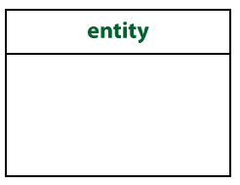
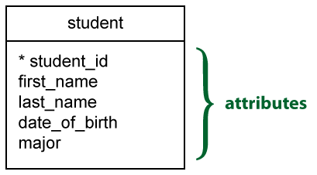
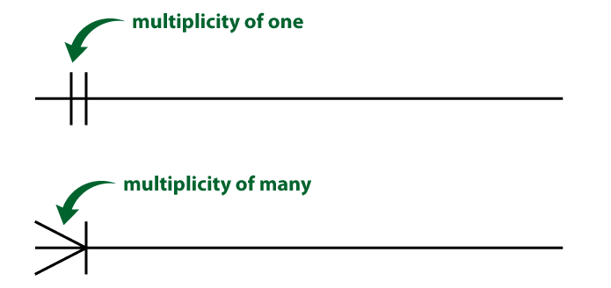
Crow’s Foot Notation
Entities
An entity is represented by a rectangle, with its name on the top. The name is singular (entity) rather than plural (entities).
Attributes
The attribute(s) that uniquely distinguishes an instance of the entity is the identifier. Usually, this type of attribute is marked with an asterisk.
Relationships
presented as a straight line. Usually, each relationship has a name, expressed as a verb, written on the relationship line. This describes what kind of relationship connects the objects.

Slide 46
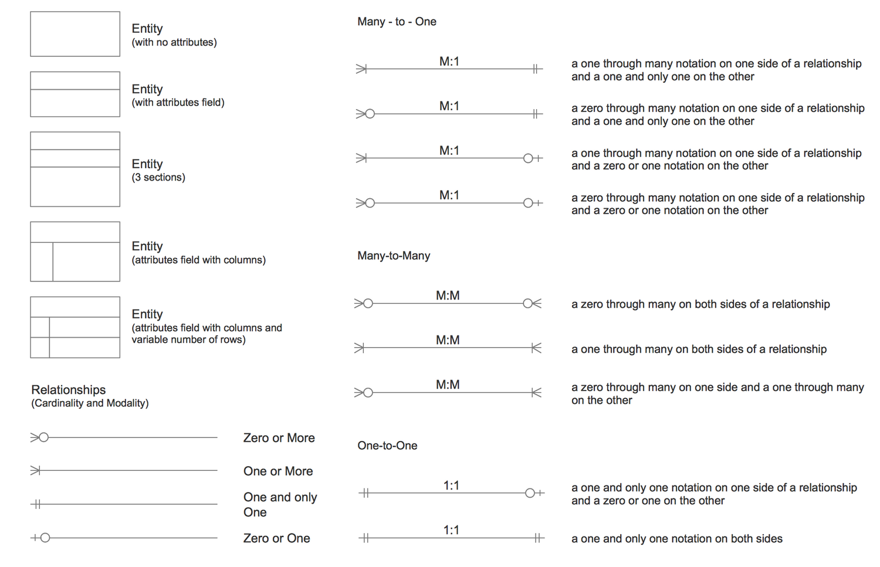
Crow’s Foot Notation

Slide 47
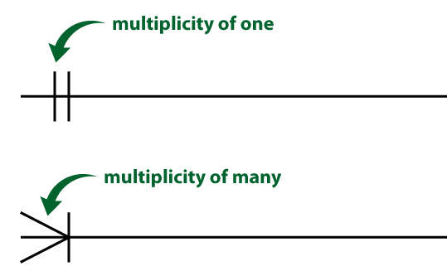
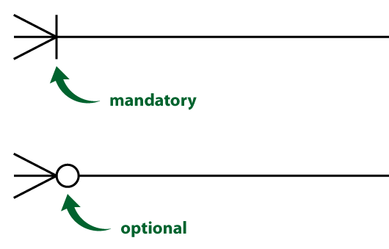
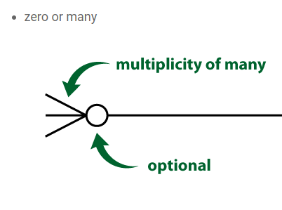
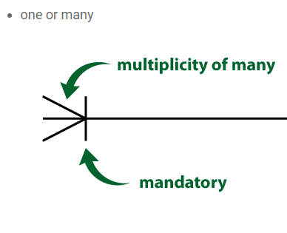
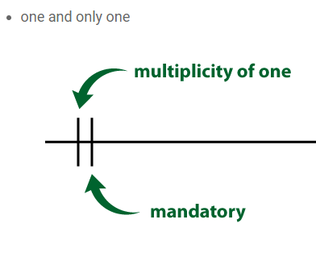
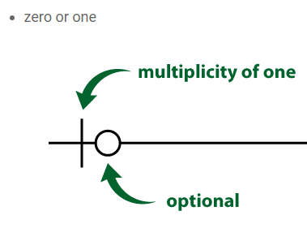
Crow’s Foot Notation
Cardinality: Relationships have two indicators. These are shown on both sides of the line.

Slide 48
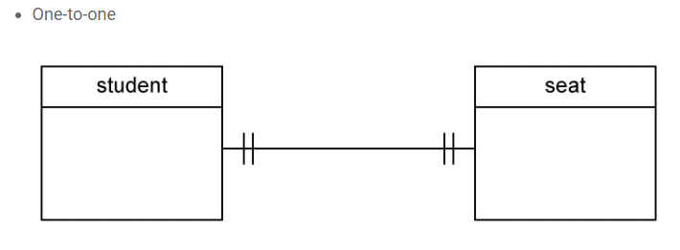
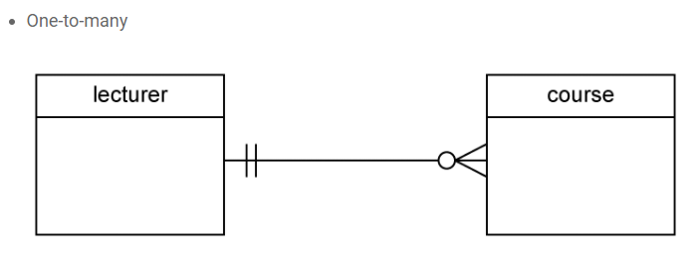
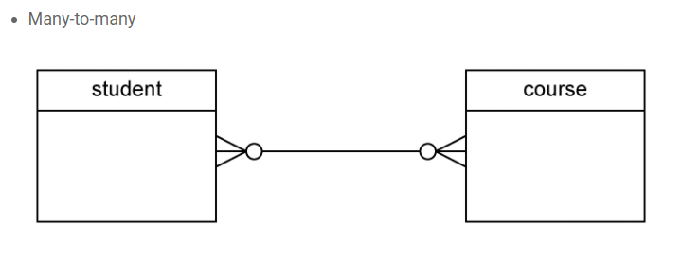
Crow’s Foot Notation: Examples
Every student can and must have one seat
Every lecturer can and must have 0 or many courses
Many Students and take many courses ..

Slide 49
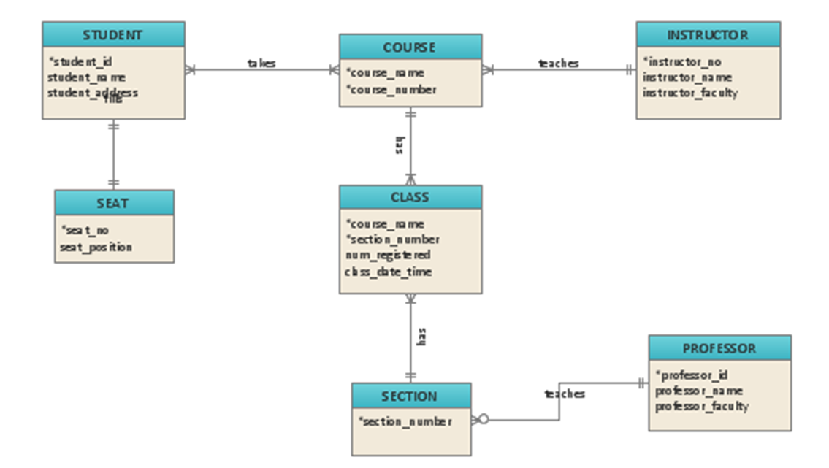
Example

Slide 50
Cardinality identification (tips)
First read a relationship in one direction, and then read the relationship in the other direction.
Each Paycheck must be issued for one and only one Employee
Each Employee may be the receiver of one or more Paychecks
issued for
Paycheck
Employee
the
receiver
of

Slide 51
Exercise 1
Write the relationship sentences for the following ERM Diagram:
Order
Issued for
Item
Bought via
Originated by
Stored in
the
originator of
the
repository of
Customer
Ware-
House

Slide 52
Relational Data Model (RDM)

Slide 53
What is relational data model?
Relational data model is the primary data model, which is used widely around the world for data storage and processing.
Relational data model is a simple way to provide all the properties and capabilities required to process data with storage efficiency.
A relational data model (in RDBMS) represents and stored in a table.
Rows in the table represent a collection of related data (object, record). These rows in the table denote a real-world entity or relationship.
The table name and column names are helpful to interpret the meaning of values in each row.

Slide 54
Terminology
Relation: A table with columns and rows
Tuple: A row of a relation
Attribute: A named column of a relation (also called as FIELD)
Domain: A set of allowable values for 1 or more attributes
Degree: The number of attributes it contains
Cardinality: The number of rows/tuples it contains
RDB: A collection of normalised relations with distinct relation names

Slide 55
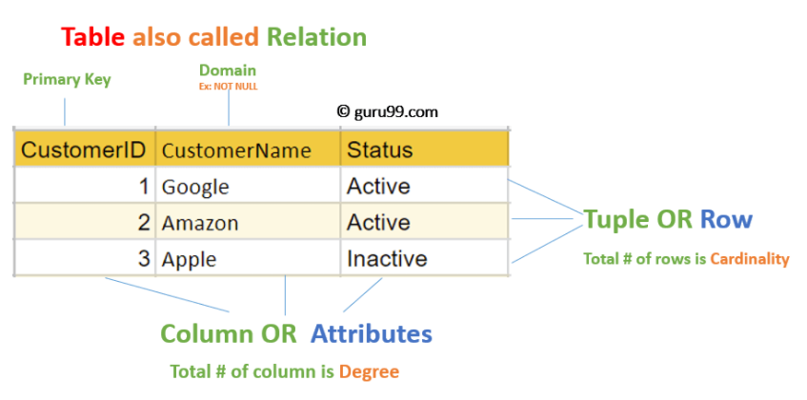
Relational Data Model (in Table)

Slide 56
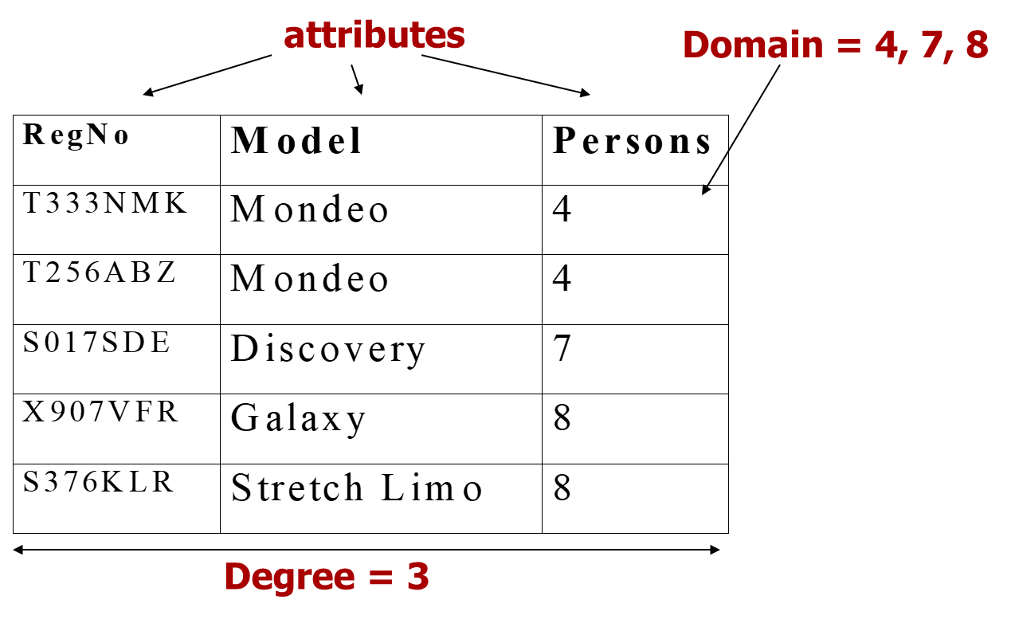
Example of Relational Table
mondeo
mondeo
galaxy

Slide 57
Relational Integrity Constraints
Every relation has some conditions that must hold for it to be a valid relation. These conditions are called Relational Integrity Constraints.
There are three main integrity constraints:
Key constraints (Entity constraints)
No two tuples can have identical values for key attributes.
A key attribute can not have NULL values.
Domain constraints
Every attribute is bound to have a specific range of values and an appropriate type.
Referential integrity constraints
If a relation refers to a key attribute (Foreign Key) of a different or same relation, then that key element must exist.

Slide 58
Other Relational Data model Rules
No duplicated rows
No necessary order to the rows (top to bottom)
No necessary order to the columns (left to right)
Each attribute value is atomic, each cell contains one and only one data value

Slide 59
Atomic – what is it?
Employee Number | Employee Name | Employee Address
3267 | Alan, Wilde | 72, Beacon Street, NW5 12JD
1735 | Sean, Bentley | 42, Ashley Court, Berkley Street, SU5 1ED
6020 | Max, Standing | 132,, West Side Street, LL5 8EL
This one is not Atomic!
To make it Atomic provide separate columns for first name, second name, house number, street number and post code

Slide 60
ERM To RDM Conversion

Slide 61
Model Conversion
ER Model, when conceptualized into diagrams, gives a good overview of entity-relationship, which is easier to understand.
RDM diagrams are near to relational schemas. It can be used easily to create relational schema for rational databases design.
Sometimes, ER Model design is called conceptual modelling and RDM is called logical modelling.
So ERM to RDM conversion is actually mapping entity and relationship.

Slide 62
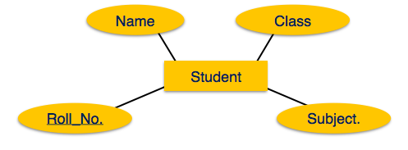
Entity Mapping
An entity is a real-world object with some attributes.
Roll_no
Name
Subject
Class
Student
Mapping Process (Algorithm)
Create table for each entity.
Entity's attributes should become fields of tables with their respective data types.
Declare primary key.

Slide 63
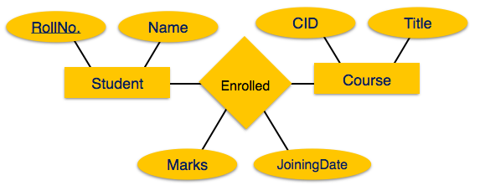
Relationship Mapping
A relationship is an association among entities.
Enrolled
* RollNo.
* CID
JoiningDate
Marks
Mapping Process
Create table for a relationship.
Add the primary keys of all participating Entities as fields of table with their respective data types.
If relationship has any attribute, add each attribute as field of table.
Declare a primary key composing all the primary keys of participating entities.
Declare all foreign key constraints.
Course
*CID
Title
Student
*RollNo
Name

Slide 64
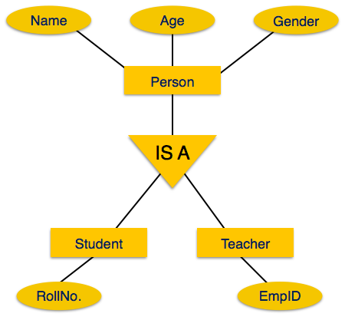
Mapping Hierarchical Entities
ERM specialization or generalization comes in the form of hierarchical entity sets.
Mapping Process
Create tables for all higher-level entities
Create tables for lower-level entities.
Add primary keys of higher-level entities in the table of lower-level entities.
In lower-level tables, add all other attributes of lower-level entities.
Declare primary key of higher-level table and the primary key for lower-level table.
Declare foreign key constraints.
Person
*NINo.
Name
Age
Gender
Student
*RollNoNINo.
Teacher
*EmpID
NINo.

Slide 65
…tips to identify cardinality….
First read a relationship in one direction, and then read the relationship in the other direction.
Each PAYCHECK must be issued for one and only one EMPLOYEE
Each EMPLOYEE may be the receiver of one or more PAYCHECKs
PAYCHECK
issued for
EMPLOYEE
the
receiver
of

Slide 66
Exercise
Write the relationship sentences for the following ERM:
ORDER
Issued for
ITEM
Bought via
Originated by
Stored in
the
originator of
the
repository of
CUSTOMER
WARE-
HOUSE

Slide 67
Solution for exercise
Each ORDER must be issued for one or more ITEMs
Each ITEM may be bought via one or more ORDERs
Each ORDER must be originated by one and only one CUSTOMER
Each CUSTOMER may be the originator of one or more ORDERs
Each ITEM must be stored in one and only one WAREHOUSE
Each WAREHOUSE may be the repository for one or more ITEMs

Slide 68
Summary
ER Model in DBMS stands for an Entity-Relationship model
The ER model is a high-level data model diagram
ER diagrams are a visual tool which is helpful to represent the ER model
ER diagrams in DBMS are blueprint of a database
Entity relationship diagram DBMS displays the relationships of entity set stored in tables a database
ER diagrams help you to define terms related to entity relationship modeling
ER Model in DBMS is based on three basic concepts: Entities, Attributes & Relationships
An entity can be place, person, object, event or a concept, which stores data in the database (DBMS)
Relationship is nothing but an association among two or more entities
A weak entity is a type of entity which doesn’t have its key attribute
It is a single-valued property of either an entity-type or a relationship-type
It helps you to defines the numerical attributes of the relationship between two entities or entity sets
ER- Diagram DBMS is a visual representation of data that describe how data is related to each other
While Drawing ER diagrams in DBMS, you need to make sure all your entities and relationships are properly labelled.

Slide 69
https://my.vertabelo.com/model/jrlmhme1ckplnqu8u1wjn8rqpmrrsmfa https://airtable.com/ Data Modeling 101 (agiledata.org) Tools: https://support.microsoft.com/en-us/office/create-a-diagram-with-chen-s-database-notation-75d28eff-2509-4faf-8cd9-3eda5fb4327b https://app.gleek.io/diagrams/8VW-K2szoI6tsTn6gMMryQ
References:
What is Data Modelling? Types (Conceptual, Logical, Physical) (guru99.com)
https://www.tutorialspoint.com/dbms/er_model_basic_concepts.htm
https://www.visual-paradigm.com/solution/free-erd-tool/
https://www.guru99.com/er-diagram-tutorial-dbms.html#12

Slide 70
Next Lecture
Requirements collection and analysis
Develop Conceptual Data Model
Develop Logical Data Model & Normalisation
ERM Database Design
Table Definitions
Physical Design
Build Database

